Slide 1

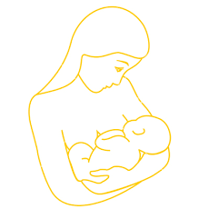

HVDRS STUDY
RESISTANCE: WE CARE
HIV-1 DRUG RESISTANCE SURVEILLANCE AMONG PARTURIENT WOMEN ON ANTI-RETROVIRAL THERAPY IN THE EASTERN CAPE, SOUTH AFRICA
*Oladele Vincent Adeniyi¹, Chikwelu Larry Obi², Daniel Ter Goon³, Benson Iweriebor², Anthony Idowu Ajayi⁴, John Lambert⁵, Anthony Okoh¹
Affiliations
(1)Faculty of science and Agriculture, University of Fort Hare, Alice. Email: vincoladele@gmail.com; aokoh@ufh.ac.za.
(2) School of Science and Technology, Sefako Makgatho Health Sciences University, Pretoria. Email: C355251@gmail.com; benvida2004@yahoo.com.
(3) Faculty of Health Sciences, University of Fort Hare, East London. Email: dgoon@ufh.ac.za.
(4) Faculty of Social Sciences & Humanities, University of Fort Hare, East London. Email: ajayianthony@gmail.com.
(5)University College Dublin/Mater Misericordiae University Hospital, Catherine McAuley Education & Research Centre, Dublin, Ireland. Email: jlambert@mater.ie.

Slide 2
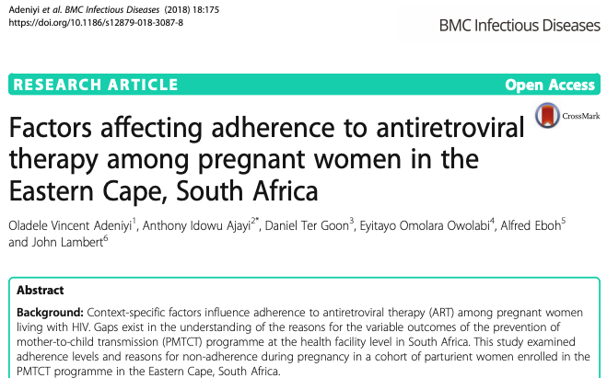
BACKGROUND
  HIV prevalence of 30.8% among pregnant women and over 95% ART coverage in the country(1,2).
  About 320, 000 children were living with HIV in SA and 12,000 new paediatric infections occurred in 2016 (3) .
  Emergence of HIV drug resistance poses significant threat to the goal of elimination of mother-to-child transmission (4,5,6).

Slide 3
RESEARCH QUESTIONS
What proportions of pregnant women delivering at high viral load have acquired clinically relevant Drug Resistance Mutations (DRMs)?
What are the patterns of DRMs in a failing cART regimen in pregnant women in the Eastern Cape, South Africa?
Findings on the frequency and pattern of HIV drug resistance mutations in pregnant women with high VL might give inform new strategies and innovations in the efforts towards eliminating MTCT.

Slide 4
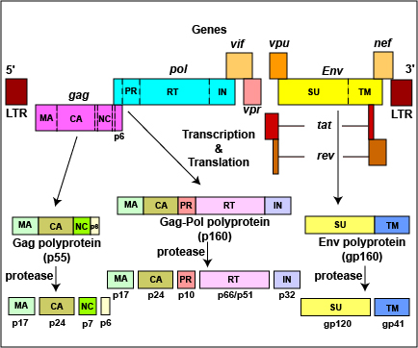
METHODS
We conducted genetic analysis on viral isolates (n=80) from plasma samples of women with probable virological failure at delivery between January and May 2018 from two large maternity centres in the Eastern Cape.
Partial pol gene covering 1030bp were amplified and sequenced according to standard protocols.
DRMs were determined by submitting the generated partial pol sequences to the Stanford Genotypic Resistance interpretation algorithm (http://hivdb.stanford.edu/pages/algs/HIVdb.html) for query on mutations associated with drug resistance.
We examined the correlates of DRMs using bivariate analysis.
Fig. 2.8. Schematic representation of HIV-1 genome. All the important open reading frames are shown
(

Slide 5
RESULTS AND DISCUSSIONS
Participants:
Age - 16 - 43 yrs.
Predominantly on EFV-based ART (82.5%) and at least 12 months (65%).
Median durations on EFV-based ART = 21 months and PI-based ART = 42 months.
Median duration on PI-based ART after switching therapy was 11 months.
Mean CD4 count = 273 (interquartile range of 3 – 759).

Slide 6
Drug Resistance Mutations in Viral Sequences
DRMS | Freq. | Percentages (%)
Major NNRTI Mutations
*K103N (Confers resistance to EFV/NVP) | 43 | 74.1
V106M | 9 | 15.5
V108I | 5 | 8.6
P225H | 10 | 17.2
K101E | 2 | 3.4
Y188L | 4 | 6.9
Major NRTI Mutations
*M184V (Confers resistance to 3TC/FTC) | 28 | 48.3
*K65R (Confers resistance to TDF) | 11 | 19.0
K70R/E (TAM) | 4 | 6.9
K219Q (TAM) | 4 | 6.9
Major PI Mutations
V82L | 1 | 1.7
L90M | 1 | 1.7
Overall, HIV-1 DRMs occurred in 58 (72.5%) viral sequences.
DRMs prevalence in EFV-based ART = 69.7% and PI-based ART = 87.7%.
In the RT gene, the predominant mutation was K103N (n=43/58; 74.1%); in EFV-based ART = 79.1% (n=34).
The prevalence of K103N in PI-based ART after switching from 1st line ART = 20.9% (n=9).

Slide 7
Bivariate Analysis of Clinical Correlates of HIV DRMs
Variables | All | DRMs | No DRMS | p-value
CD4 Count
<200 | 24 (34.3) | 23 (95.7) | 1 (4.3) | 0.002
200-349 | 24 (35.8) | 13 (54.2) | 11 (45.8)
350-499 | 14 (20.9) | 11 (78.6) | 3 (21.4)
≥500 | 6 (9.0) | 2 (33.3) | 4 (66.7)
WHO Stage
I | 44 (62.0) | 28 (63.6) | 16 (36.4) | 0.304
II | 11 (15.5) | 9 (81.8) | 2 (18.2)
III | 14 (19.7) | 12 (85.7) | 2 (14.3)
IV | 2 (2.8) | 1 (50.0) | 1 (50.0)

Slide 8



ACKNOWLEDGEMENTS

